Slide 1




Improving Image Captioning with Conditional Generative Adversarial Nets
Chen Chen, Shuai Mu, Wanpeng Xiao, Zexiong Ye, Liesi Wu, Qi Ju

Slide 2
Main
Overview
Proposed Algorithm
Introduction
Conclusion
3
5
1
2
4
RL-based
image captioning
Experiments

Slide 3
Introduction
Part I

Slide 4
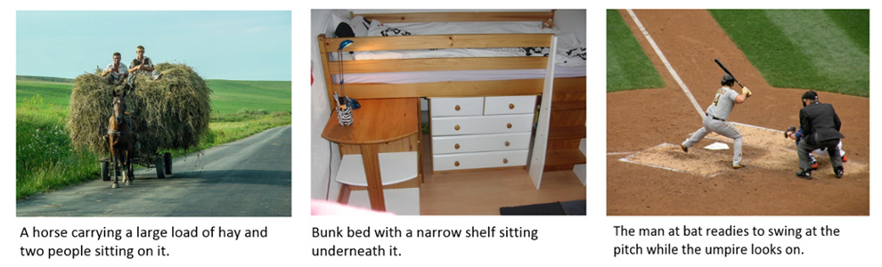
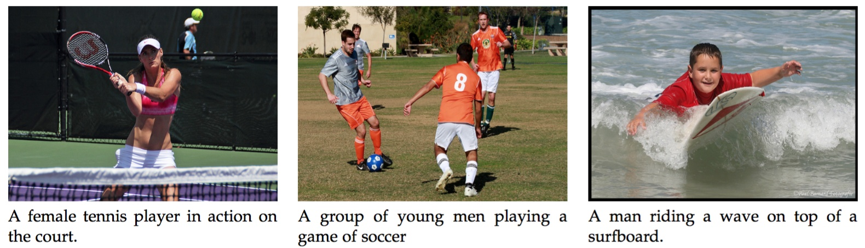
Introduction
Image captioning

Slide 5
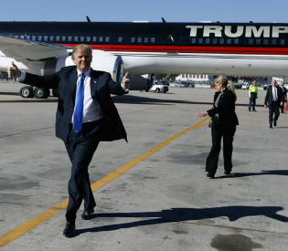
Introduction
Basic framework
Cross Entropy
N-gram based
SPICE
Discriminative metric
CNN
CNN+RNN multimodal
R-CNN
RNN
LSTM
CNN
attention
ENCODER
DECODER
Loss
Function
features
words
MLE
Reinforcement Learning
GANs

Slide 6
RL-based
image captioning
Part II

Slide 7
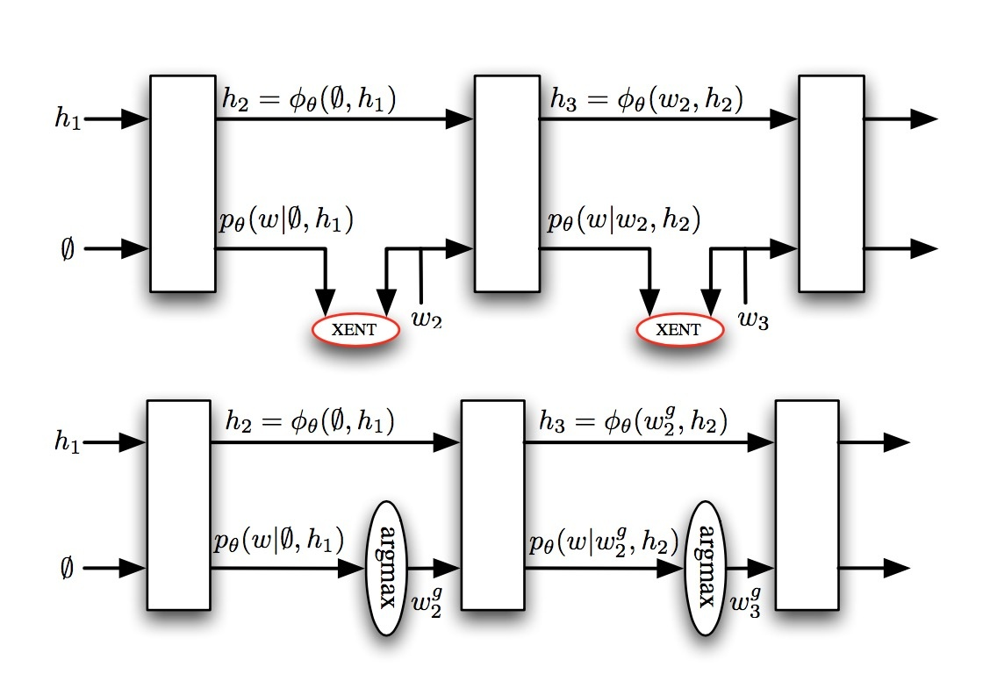
RL-based image captioning
Why use reinforcement learning?
1: exposure bias
2: do not optimize the whole sequence
BLEU-1, BLEU-2, …
ROUGE
METEOR
CIDER
SPICE
…

Slide 8
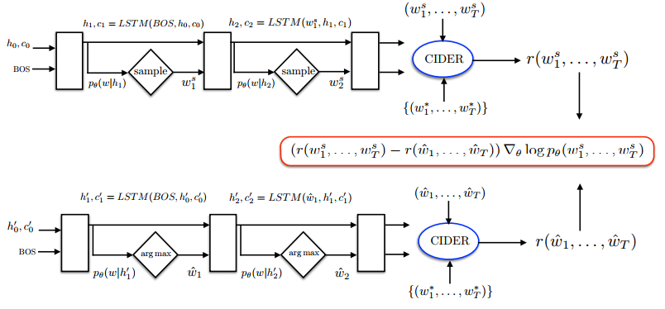
RL-based image captioning
Self-critical sequence training
CE loss
RL loss
Rennie, Steven J., et al. "Self-critical sequence training for image captioning." arXiv preprint arXiv:1612.00563 (2016).

Slide 9
Proposed
Algorithm
Part III

Slide 10

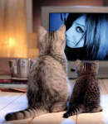
Proposed algorithm
Overall framework
RL Update
RL Update
RL Update
Disriminator
language evaluator
Attention
RNN
CNN
Generator
ground truth sentence

Slide 11
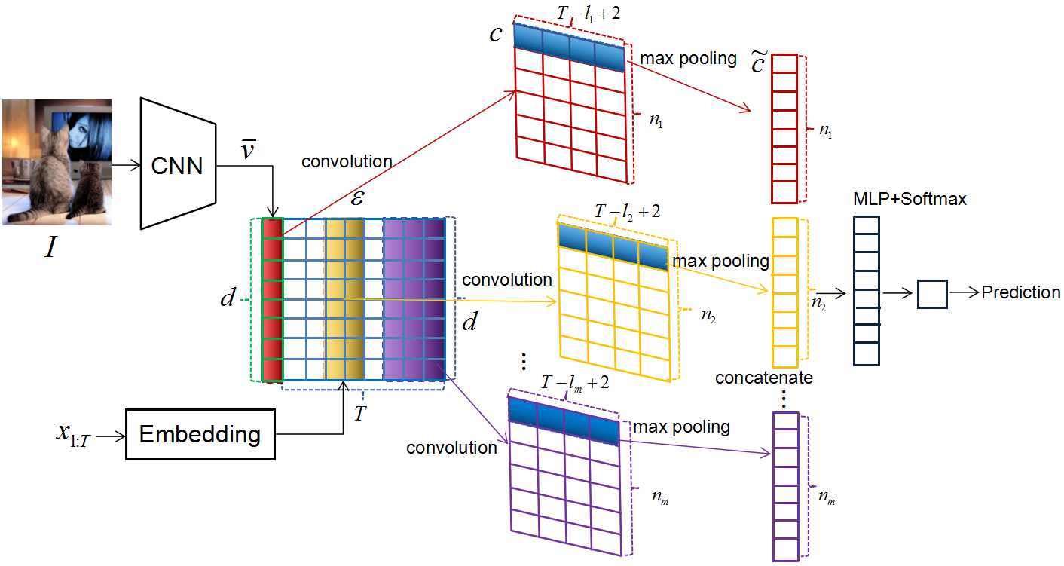
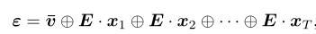
Proposed algorithm
CNN-based discriminator

Slide 12
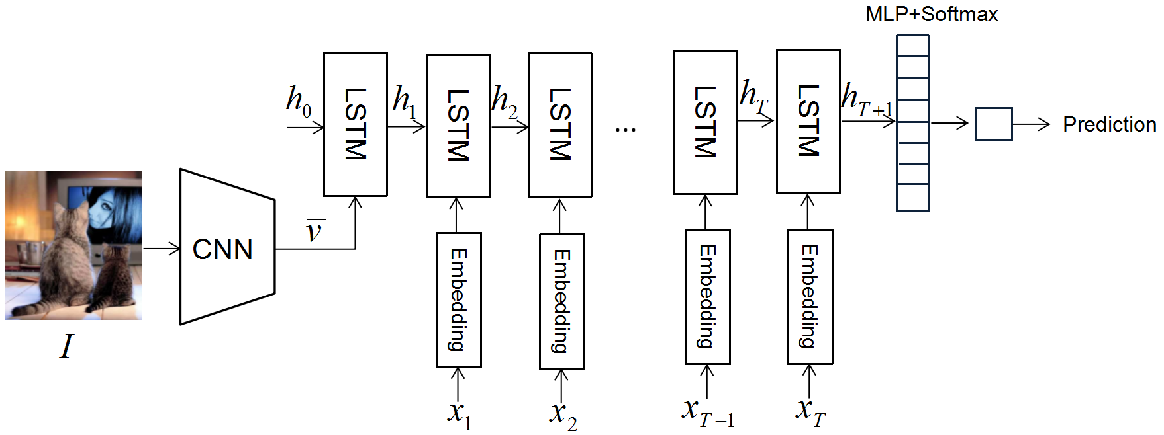
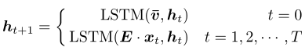
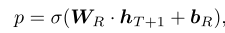
Proposed algorithm
RNN-based discriminator

Slide 13
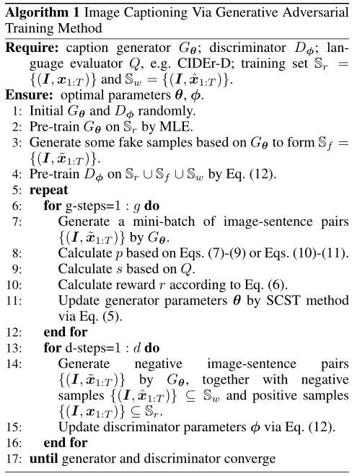
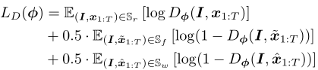
Proposed algorithm
Training pipeline

Slide 14
Experiments
Part IV

Slide 15
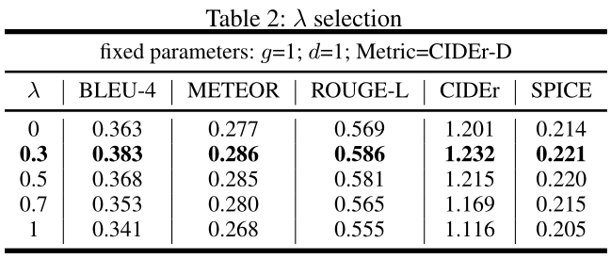
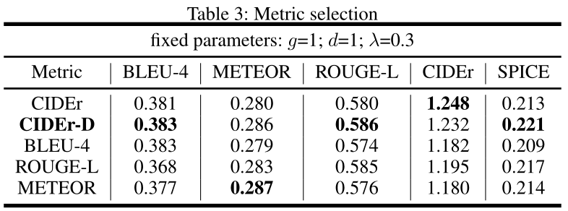
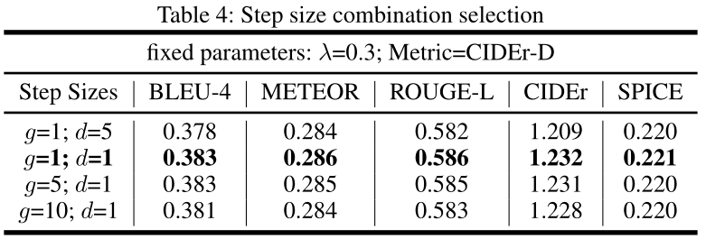
Experiments
Parameters determination

Slide 16
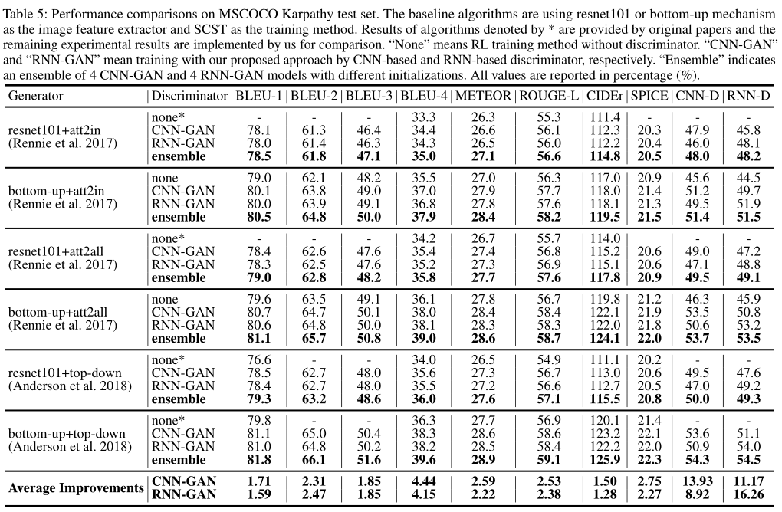
Experiments
Comparisons

Slide 17
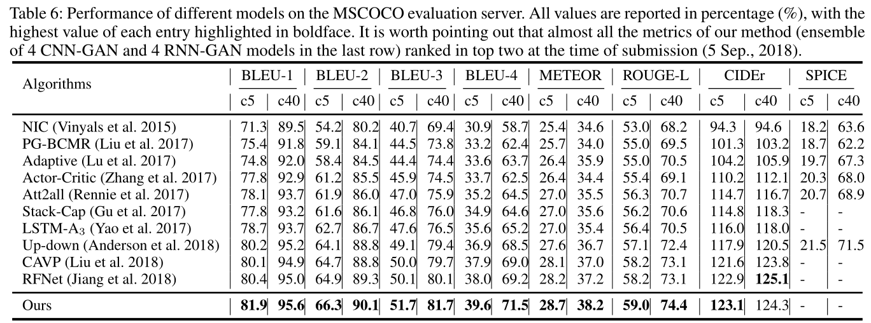
Experiments
MSCOCO online test serve

Slide 18
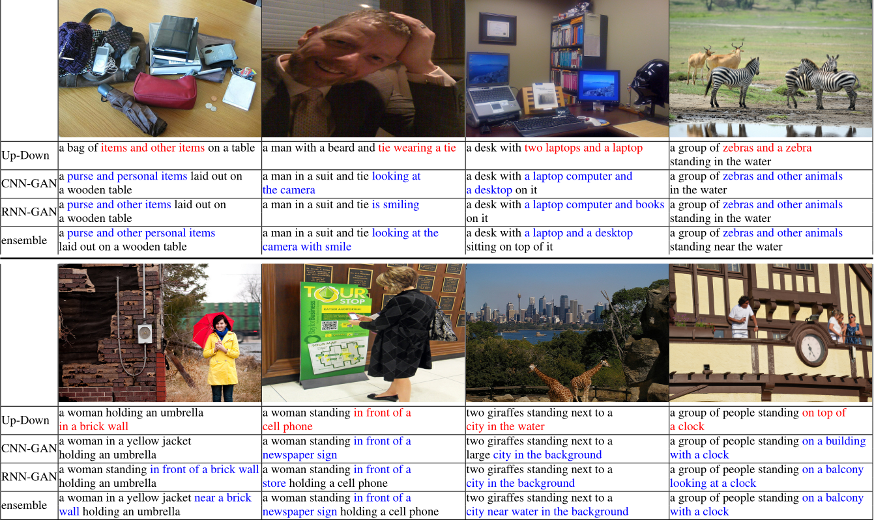
Experiments
Examples

Slide 19
Conclusion
Part V

Slide 20
Conclusion
2
1
Effective
Generic
Consistently improve all automatic evaluation metrics, e.g. BLEU, ROUGE, METEOR, CIDER, SPICE
A generic framework to improve any RL-based image caption algorithm.
Conclusion
3
4
Evaluator
Ensemble
Well trained CNN-based and RNN-based discriminators can also be viewed as evaluators for image captioning.
Ensemble of CNN-GAN and RNN-GAN model can further improve performance

Slide 21
Q&A
Thanks

